Slide 1
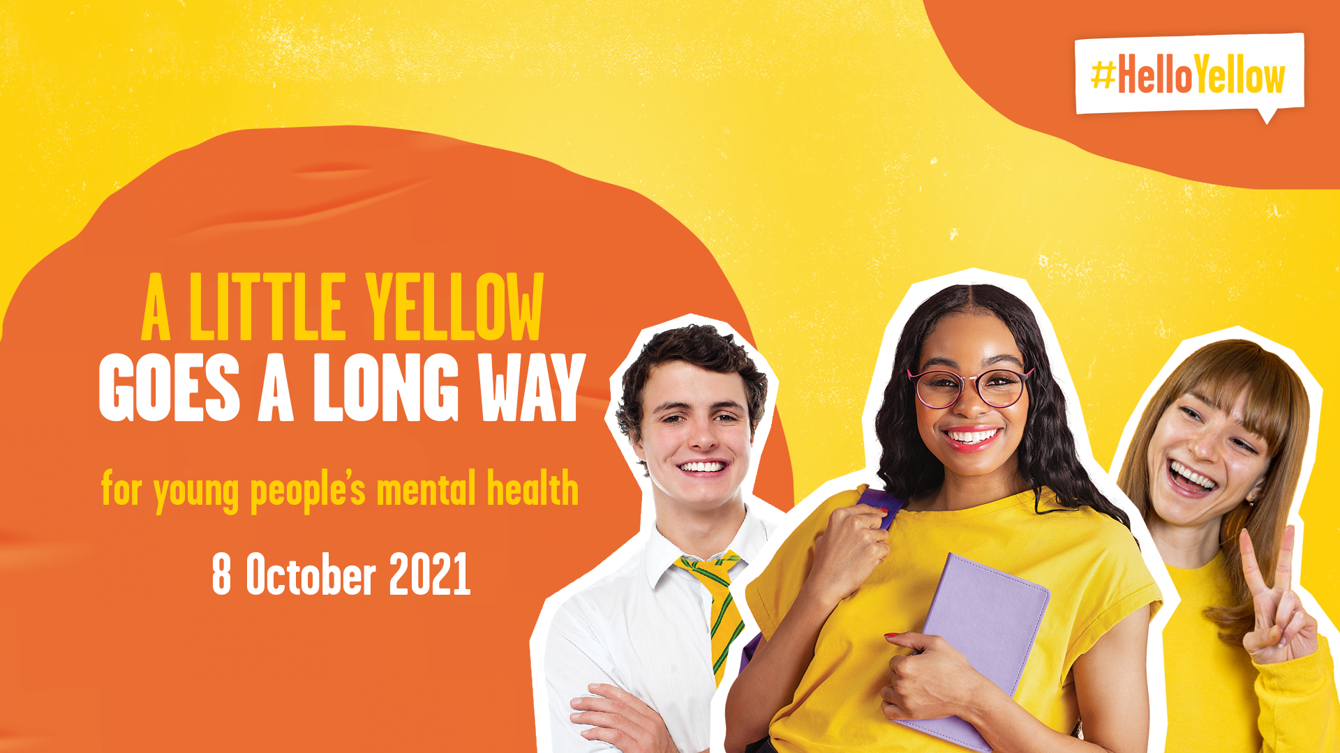

Slide 2



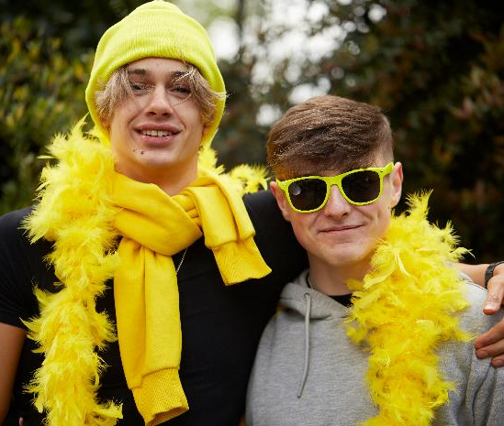
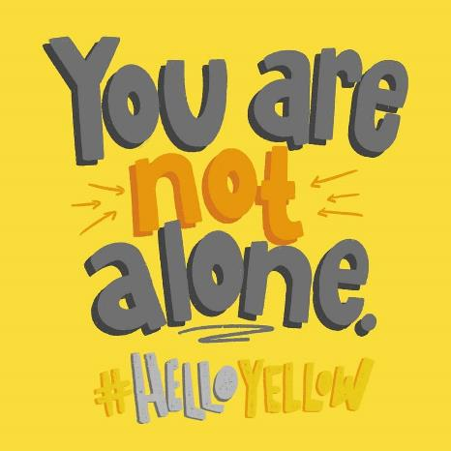
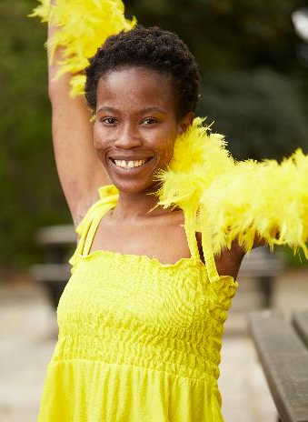
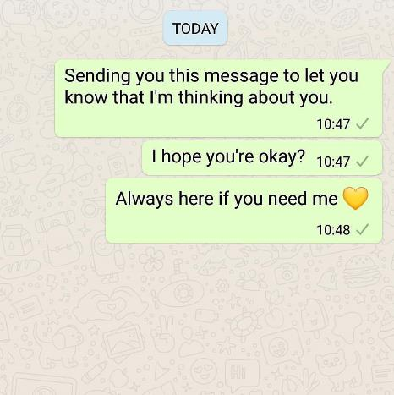


It’s !
Today we’re showing young people that they’re not alone with their mental health and raising vital funds for YoungMinds.

Slide 3

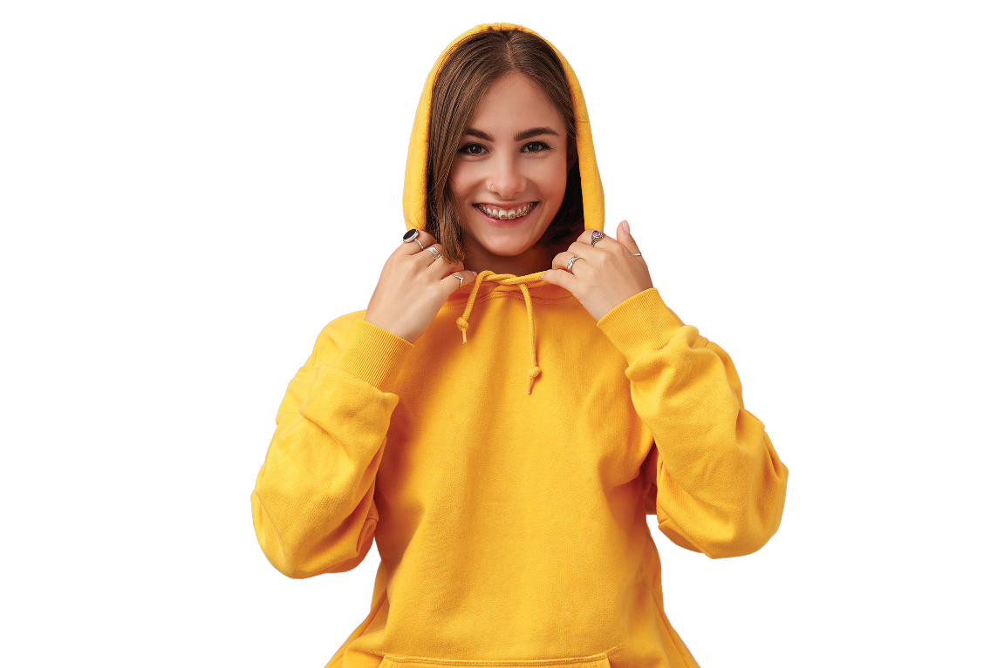
It’s normal to have ups and downs – and this year might have felt a little more down than up. But it’s the little things that have got us through it.
Wearing yellow today is a little thing we can do to make a big difference. Today let’s celebrate the little things we can do to look after ourselves and support eachother, and together, we can show young people they’re not alone with their mental health.
The more people who show they care, the more comfortable young people will feel about talking to someone if they’re struggling.
Why are we wearing yellow?

Slide 4
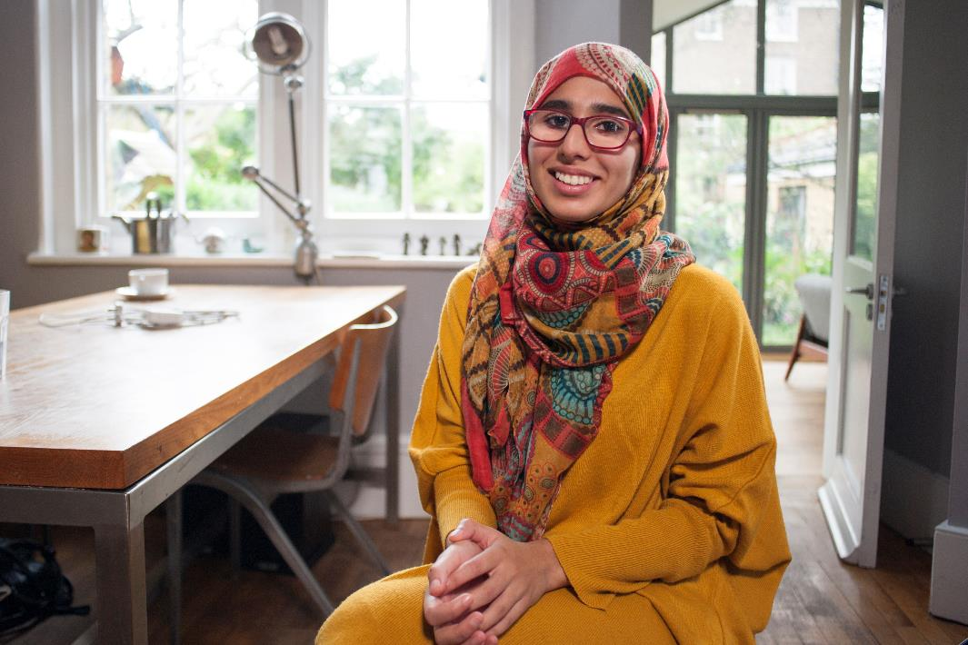

Meet Aaliyah

Slide 5
Here’s how your fundraising will make a difference
A donation of £5 will help young people share their mental health experiences, which will reach thousands more young people to give them hope at this difficult time.
A donation of £10 ensures a Helpline Volunteer is on the end of the phone to provide information and support to distressed parents. They need our support more than ever.
A donation of £30 gives a parent or carer a 50-minute telephone call with a qualified mental health front line worker, who can provide clinical advice and guidance.

Slide 6



Thank you!

